Slide 1
QuickEat
Ang Hui Shan | Chan Jing Chuan Victor | Wah Hui Ning | Yu ZhiWei Ryan | Violet Leong Sin Yee

Slide 2




QuickEat

Slide 3
QuickEat
Loading…

Slide 4
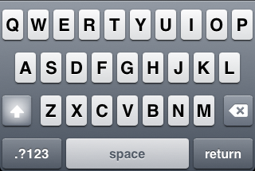
Log In
Matriculation Number
Password
Log In
Don’t have an account?
Sign Up

Slide 5
Back
Account Setup
Matric No.
First Name
Last Name
Email
Password
Confirm Password
Next

Slide 6
Back
Add Card
Card Type
e.g. MasterCard
Card Number
Expiry Date
CCV Number
Add Card

Slide 7
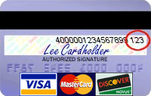
Back
Add Card
Card Type
You can find your CCV number at the back of your card.
e.g. MasterCard
Card Number
Expiry Date
CCV Number
Okay
Add Card

Slide 8




Back
Top Up
Profile
You have
$20.40
Tap to add value to your account
Transaction History
Your last activity was 30th Oct: Topping up your card: $20
Tap here to view more history
You are signed in as
violet@nus.edu.sg
Tap to sign out
Orders
New Order
Profile

Slide 9
Current Orders
No current orders!
Click on ‘New Order’ to order now.
Orders
New Order
Profile

Slide 10
Current Orders
Order #00234
Claim Order
Orders
New Order
Profile

Slide 11
Current Orders
Order #00234
Claim Order
Order #00241
5 Minutes
To collection
Orders
New Order
Profile

Slide 12
Current Orders
Order #00234
Claim Order
Order #00241
5 Minutes
To collection
Order items:
Broccoli, Beansprouts, Fishball, Bee Hoon, Soup
Orders
New Order
Profile

Slide 13
Current Orders
Order #00234
Claim Order
Order items:
Broccoli, Xiao Bai Cai, Golden Mushroom, Egg Noodles, Dry
Order #00241
5 Minutes
To collection
Orders
New Order
Profile

Slide 14
Claim Order
Your Order No. is:
#00234
Purchased On:
Wednesday 31st Oct ‘12
*Please present this to the store owner for collection. Thank you!
Orders
New Order
Profile

Slide 15
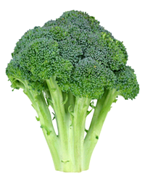
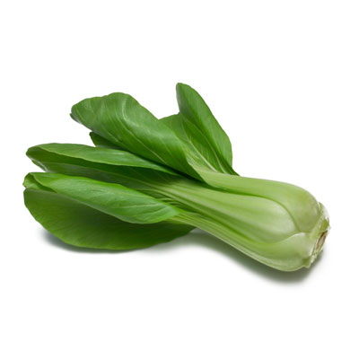
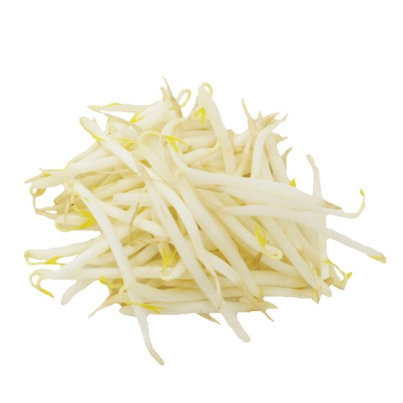
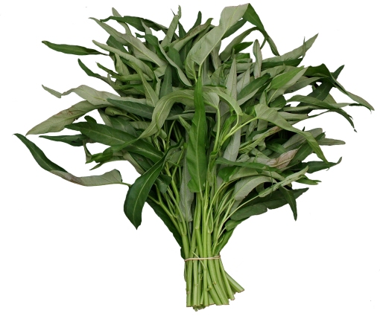
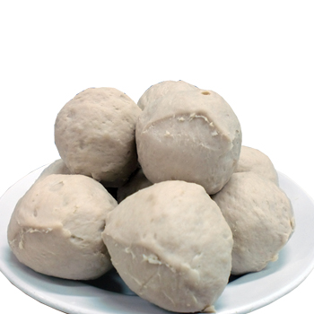
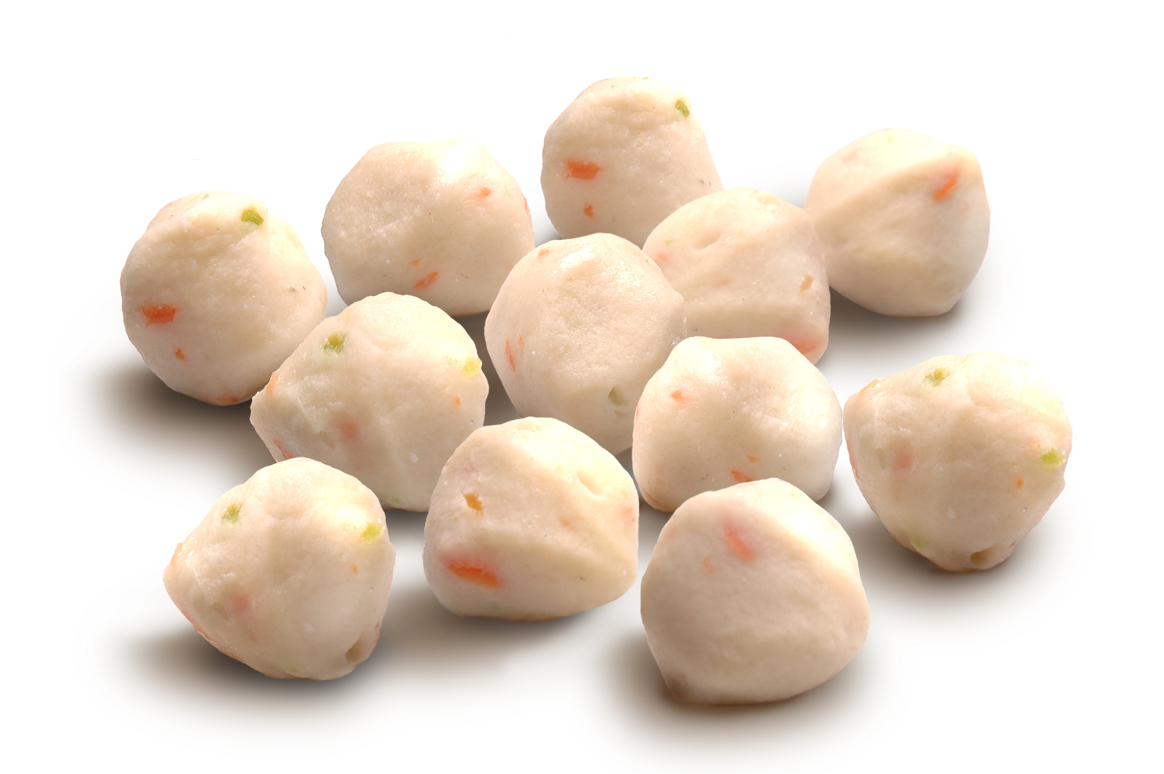
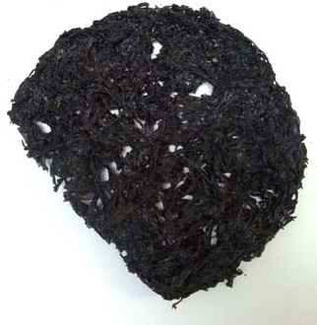
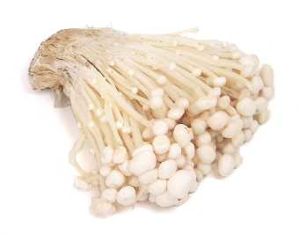
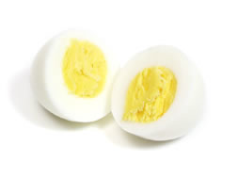
Back
Next
Select Ingredient
Broccoli
Xiao Bai Cai
Beansprout
KangKong
Fishball
Meatball
Seaweed
Golden
Mushroom
Egg
Selected Items
$ 0.00
Total Price:
Orders
New Order
Profile

Slide 16
Back
Next
Select Ingredient
Broccoli
Xiao Bai Cai
Beansprout
KangKong
Fishball
Meatball
Seaweed
Golden
Mushroom
Egg
Selected Items
$ 0.50
Total Price:
Broccoli
Orders
New Order
Profile

Slide 17
Back
Next
Select Ingredient
Broccoli
Xiao Bai Cai
Beansprout
Are you sure you want to clear your current order?
KangKong
Yes
No
Fishball
Meatball
Seaweed
Golden
Mushroom
Egg
Selected Items
$ 0.50
Total Price:
Broccoli
Orders
New Order
Profile

Slide 18
Back
Next
Select Ingredient
Broccoli
Xiao Bai Cai
Beansprout
KangKong
Fishball
Meatball
Seaweed
Golden
Mushroom
Egg
Selected Items
$ 1.00
Total Price:
Broccoli
Xiao Bai Cai
Orders
New Order
Profile

Slide 19
Back
Next
Select Ingredient
Broccoli
Xiao Bai Cai
Beansprout
Are you sure you want to clear your current order?
KangKong
Yes
No
Fishball
Meatball
Seaweed
Golden
Mushroom
Egg
Selected Items
$ 1.00
Total Price:
Broccoli
Xiao Bai Cai
Orders
New Order
Profile

Slide 20
Back
Next
Select Ingredient
Broccoli
Xiao Bai Cai
Beansprout
KangKong
Fishball
Meatball
Seaweed
Golden
Mushroom
Egg
Selected Items
$ 1.50
Total Price:
Broccoli
Golden
Mushroom
Xiao Bai Cai
Orders
New Order
Profile

Slide 21
Back
Next
Select Ingredient
Broccoli
Xiao Bai Cai
Beansprout
Are you sure you want to clear your current order?
KangKong
Yes
No
Fishball
Meatball
Seaweed
Golden
Mushroom
Egg
Selected Items
$ 1.50
Total Price:
Broccoli
Golden
Mushroom
Xiao Bai Cai
Orders
New Order
Profile

Slide 22
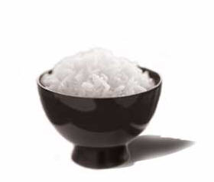
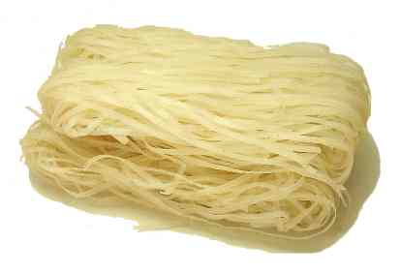
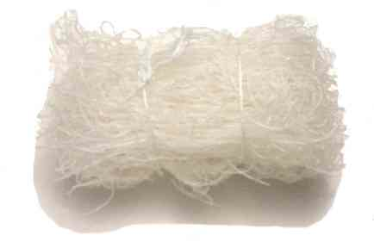
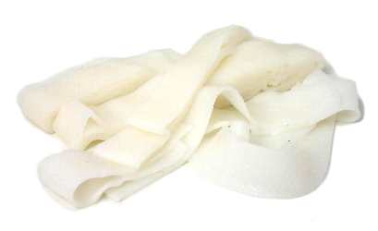
Back
Next
Select Ingredient
Rice
Egg Noodles
Bee Hoon
Kway Tiao
Selected Items
$ 1.50
Total Price:
Broccoli
Golden
Mushroom
Xiao Bai Cai
Orders
New Order
Profile

Slide 23
Back
Next
Select Ingredient
Rice
Egg Noodles
Bee Hoon
Are you sure you want to clear your current order?
Kway Tiao
Yes
No
Selected Items
$ 1.50
Total Price:
Broccoli
Golden
Mushroom
Xiao Bai Cai
Orders
New Order
Profile

Slide 24
Back
Next
Select Ingredient
Rice
Egg Noodles
Bee Hoon
Kway Tiao
Selected Items
$ 1.50
Total Price:
Broccoli
Golden
Mushroom
Xiao Bai Cai
Egg Noodles
Orders
New Order
Profile

Slide 25
Back
Next
Select Ingredient
Rice
Egg Noodles
Bee Hoon
Are you sure you want to clear your current order?
Kway Tiao
Yes
No
Selected Items
$ 1.50
Total Price:
Broccoli
Golden
Mushroom
Xiao Bai Cai
Egg Noodles
Orders
New Order
Profile

Slide 26
Back
Next
Select Ingredient
Dry /
No Soup
Soup
Laska
Selected Items
$ 1.50
Total Price:
Broccoli
Golden
Mushroom
Xiao Bai Cai
Egg Noodles
Orders
New Order
Profile

Slide 27
Back
Next
Select Ingredient
Dry /
No Soup
Soup
Laska
Are you sure you want to clear your current order?
Yes
No
Selected Items
$ 1.50
Total Price:
Broccoli
Golden
Mushroom
Xiao Bai Cai
Egg Noodles
Orders
New Order
Profile

Slide 28
Back
Next
Select Ingredient
Dry /
No Soup
Soup
Laska
Selected Items
$ 1.50
Total Price:
Dry /
No Soup
Broccoli
Golden
Mushroom
Xiao Bai Cai
Egg Noodles
Orders
New Order
Profile

Slide 29
Back
Next
Select Ingredient
Dry /
No Soup
Soup
Laska
Are you sure you want to clear your current order?
Yes
No
Selected Items
$ 1.50
Total Price:
Dry /
No Soup
Broccoli
Golden
Mushroom
Xiao Bai Cai
Egg Noodles
Orders
New Order
Profile

Slide 30

QuickEat
Total Price:
$ 1.50
Items
Broccoli
Xiao Bai Cai
Golden Mushroom
Egg Noodles
Dry/No Soup
Place Order
Orders
New Order
Profile

Slide 31
QuickEat
Your Order ID:
#00234
Estimated Waiting Time:
10 – 15mins
$1.50 has been deducted from your account
STATUS: In Queue
Cancel Order
Orders
New Order
Profile

Slide 32
QuickEat
Your Order ID:
Are you sure you want to cancel your order?
#00234
Yes
No
Estimated Waiting Time:
10 – 15mins
STATUS: In Queue
Cancel Order
Orders
New Order
Profile

Slide 33
QuickEat
Your Order ID:
#00234
Estimated Waiting Time:
10 – 15mins
STATUS: Preparing
Cancel Order
Orders
New Order
Profile

Slide 34
QuickEat
Your Order ID:
Are you sure you want to cancel your order?
If you are cancel your order now, a penalty of $2.00 will be deducted from your account.
#00234
Estimated Waiting Time:
Yes
No
10 – 15mins
STATUS: Preparing
Cancel Order
Orders
New Order
Profile

Slide 35
QuickEat
Your Order ID:
#00234
Estimated Waiting Time:
10 – 15mins
STATUS: Ready
Orders
New Order
Profile

Slide 36
QuickEat
Your Order ID:
#00234
Your order is ready for collection.
Estimated Waiting Time:
Okay
10 – 15mins
STATUS: Ready
Orders
New Order
Profile

Slide 37
QuickEat
Your Order ID:
#00234
Estimated Waiting Time:
10 – 15mins
STATUS: Done
Orders
New Order
Profile

Slide 38
QuickEat
Remaining Credit:
S$ 17.50
Top Up
Orders
New Order
Profile

Slide 39






QuickEat
Top Up
Account Balance
New Order
Order History

Slide 40
QuickEat
Top Up
Amount
Payment Method
Orders
New Order
Profile

Slide 41
QuickEat
Order History
Today
9.30am
Top Up $20.00
10.30am
Order with Items:
Broccoli
Beansprouts
Fishball
Bee Hoon
Soup
Order Again
3.00pm
Order with Items:
Xiao Bai Cai
Beansprouts
Fishball
Kway Tiao
Rice
Order Again
Yesterday
Last Week
Orders
New Order
Profile

Slide 42
QuickEat
Ingredients
Noodles/Rice
Soup
Broccoli
Xiao Bai Cai
Beansprout
KangKong
Fishball
Meatball
Seaweed
Golden
Mushroom
Egg
Selected Items
$ 2.70
Total Price:
Soup
Broccoli
Beansprout
Fishball
Bee Hoon
Orders
New Order
Profile

Slide 43
QuickEat
Ingredients
Noodles/Rice
Soup
Broccoli
Xiao Bai Cai
Beansprout
KangKong
Fishball
Meatball
Seaweed
Golden
Mushroom
Egg
Selected Items
$ 0.00
Total Price:
Laksa
Xiao Bai Cai
Beansprout
Fishball
Kway Tiao
Orders
New Order
Profile

